Slide 1

SAP UI5 and Fiori Training with OData Services
on
SAP Web IDE
HTML5, CSS, Java Script, J Query, Complementary OOPS ABAP, Component JS, Routing, Manifest, Custom Controls
Latest topics covered without copy paste of code.
http://www.onlinefioritrainings.com

Slide 2
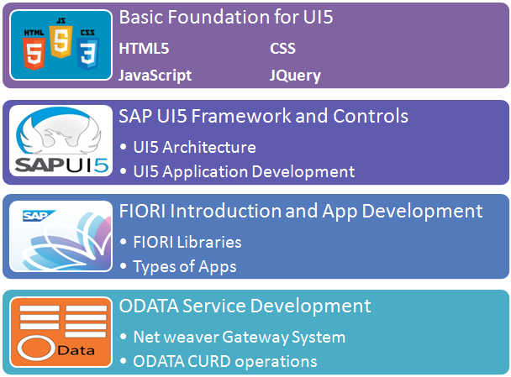

Slide 3
Start Date: 16th Apr2018 Expected End Date: 25th June 2018 Weekdays 7-8 AM India time Duration : 40+ Hours + Complementary OOPS ABAP

Slide 4
Flow of program:
Initialization – variable declaration, values, dependencies
Place your UI element – Screen element – what user see.
Processing logic – handle validations, read inputs, manipulate data, access db, navigation
Output – Display results
In SAP UI5:
SAP UI5 framework: A framework is a collection of libraries, each of these libraries includes classes, each of these class includes methods to full fill certain task.
SAP UI5 is a framework which is based on open Standards like HTML5, CSS, JS, JQ to be able to build responsive web applications.
SAP GUI
WD
BSP
SAP UI5

Slide 5
Index.html
<head>
initialization
</head>
<body>
</body>
CDN
Data: lv_matnr type matnr.
var variableName = new libraryName.ClassName(sId, SProp);
sId – unique id of your UI Control
sProp = properties of a UI control e.g. label, value, text, width, height, enable, visible etc.
Event name and action handler.
bootstrap

Slide 6
Browser
Mobile
(Client)
Angular JS, UI5
www.example.com
Web server
(ip address – 102.165.20.3)
HTTP, FTP, SMTP
ABAP, Java, .NET, Perl, Python,
Node JS, XSJS
8080
102.165.20.3
request
response
HTML, CSS, JS
HTML, CSS, JS
HTML, CSS, JS
Web Projects
HTML, CSS, JS
Webdynpro
UI5
Web Projects
Web Projects
Web Projects

Slide 7
HTML – stands for Hyper Text Mark up Language , It is not a programming language, HTML is used for creating static web Content. The content is created by using HTML tags. E.g. Input, div, img, button etc.
CSS – Stands for Cascading Style Sheet, it is used to beautify the HTML content e.g. Formatting, text colouring, boarder, width etc.
JS – Stands for Java Script, this is the programming language of browser. It is no where related to Java programming language.
Funda Fox:
Browser only understand HTML, CSS and Java script directly.
Eclipse (Open Source IDE)
SAP WebIDE
Benefits of WebIDE
It runs on browser, hence you can access from anywhere, any device, any time
It built for UI5 development
Connectivity to SAP server
SAP Extensibility Pane
Trial Edition
(single developer)
Productive version
(SCP)

Slide 8
Setup java runtime environment (JRE) to work with these tools. ➔ JDK (1.8)
http://www.oracle.com/technetwork/java/javase/downloads/jdk8-downloads-2133151.html
How to setup WebIDE (http://tools.hana.ondemand.com/)
Download WebIDE personal Edition (correct bit size)
DO NOT EXTRACT FROM DOWNLOADS FOLDER DIRECTLY,
Copy the downloaded file to your computer folder (D:\MyWebIDE)
Extract here option (Winrar software from internet)
Eclipse folder will be generated in the main folder
Go to eclipse folder, Run orion.exe (do not close orion window)
Open (chrome) browser, type url
localhost:8080/webide/index.html
Eclipse/WebIDE
compiled
JRE
Command line
KERNEL (OS)
Assem
MOV A,B
01010101
CPU

Slide 9
HTML – HTML stands for Hyper Text Markup Language It is used to create static web pages.
Version | Year
HTML | 1991
HTML 2.0 | 1995
HTML 3.2 | 1997
HTML 4 | 1999
XHTML | 2000
HTML 5 | 2014
W3C – World Wide Web Consortium – responsible for versions of HTML. All the browsers IE, Firefox, chrome, safari etc. Has to comply to the guidelines provided by W3C. Because browser only understand HTML directly.
HTML page is also known as HTML document. To indicate that its a HTML document, we start our page using special tag called doctype.
<!DOCTYPE html>

Slide 10
Difference between HTML and HTML5?
HTML 5 is just the latest version of HTML
With HTML 5 the doc type declaration was simplified, in older version it was something like below
<!DOCTYPE SCHEMA=“HTML_NDN” version=“XHTML.0”>
HTML5 is more liberal in nature, we don’t need to put an end tag for many of tags now e.g. Meta, input, img etc.
New type of input types were introduced like number, date, color, email, contact etc.
Automatic validation has been introduced before submit.
New structural tags were introduced.
Direct support of audio and video tab.
Difference between UI5 and HTML5?
HTML 5 is a mark up but UI5 is a framework.
HTML versions are released by W3C, UI5 versions are released by SAP.

Slide 11
Basics of HTML file:
Every document has a head and body tag
Every tag will follow below syntax
<tagName>content</tagName>
HTML is a TREE data structure
<!DOCTYPE html>
<head>
<body>

Slide 12
New structural elements were introduced in HTML5
<header>
Exercise: in ordered list and un ordered list tags which Anubhav created, go ahead and add video URL of each topic from www.onlinefioritrainings.com
<section>
<article>
<section>
<article>
<footer>

Slide 13
thead
th | th
Td | Td
Td | Td
Td | Td
Td | Td
table
tbody
Iframe control: control which is used to embed another html document inside your html document.

Slide 14
Web developer tools for browser : open by using F12 key on any browser.
The HTML tree structure which is displayed inside the browser is known as DOM (Document Object Model)
Block levels in HTML – they don’t have their own footprint on UI. The purpose is to give structure to HTML content.
div – division tag – used to include elements inside a block which always starts from a new line.
Span - used to group elements but doesn’t start with a new line.
Typically, every HTML element can have a property called id, id has to be unique on page for an element.
You also provide a classification of element which belongs to similar group. class=“address”

Slide 15
CSS stands for Cascading Style Sheet, it is used to style HTML content.
Why ?
<p>He was able to <b>achieve<b> all his <color value=“red”><font value=“Calibri”>goals</font><goal> by end to last year. The new year looks promising for him.</p>
HIGH MAINTENANCE. CSS3
How to apply CSS on HTML Content?
Inline CSS – inline CSS is used apply style at a particular HTML element level. In precedence level this takes highest precedence.
<tagName style=“prop: value; prop2:value; prop3:value...”>Content</tagName>
Disadvantage: you need to provide style at each element level which is again lead to high maintenance in future.
Internal CSS – Internal style is applied at the page level using style tag. This simplifies targeting multiple elements using same style code.
<style>
selector {
prop: value;
prop: value;
}
</style>
Selector is the targeted element(s) on which this style will be applied.
tagName, .className , #id

Slide 16
Responsive Web Design: An web Application which adapts itself according to the device automatically.
Exercise: there 3 images inside the project Anubhav has put, Place all 3 images in a single line with square box (200px w and h).
3. External CSS

Slide 17
CSS Box Model
border
border
HTML Element
HTML Element
padding
padding
Margin
What is the actual size of HTML element it takes on screen – HTML Element Width + Padding + Border + Margin

Slide 18
Pesudo classes in CSS:
It is an event which gets applied when we do an activity on UI element. Example HOVER.
Selector: Psedo-class{
--style code
}

Slide 19
What is JS?
JS stands for Java Script, it is the only programming language browser has.
What is JS is used for?
Writing the manipulation and imperative logic (arithmetic, string, date and time etc.)
Can be used to manipulate the DOM
Used to check user input
Able to create dynamic UI element on UI.
Change CSS @ runtime
2 types of Java Script:
Client Side JS – The complete code runs on client side (Browser – the gets downloaded to browser and user can see that in Resources tab, same can be debugged also in browser). The power of Morden browser makes it possible to run code in client side. The main advantage is to avoid unnecessary load on server, send a call to server when is absolutely needed for example saving data into db. It is used to develop the UI applications.
Server Side JS – The code gets executed in server, The server provides runtime support for server side JS. Purpose is to provide functionality like DB lookup, Send email, Store Passwords, Manipulation, Control Flow, Server side validations etc.
Examples are Node js, XSJS (used inside HANA).

Slide 20
You can apply the JS using one of three ways:
Inline JS: At the tag level. There is no reuse.
<tagName eventName=“js code”></tagName>
Internal JS
It is applied at page level by writing reusable functions. We use a special tag in head of page as <script></script>.
External JS
It kept in a separate file and file is reference using below syntax
<script src=“path of the file”></script>
Event: When user perform an action on UI, it triggers an event. For example, when you click on a button onclick event will be
called. We have events for every thing e.g. Ondblclick, onmouseover, onkeypress, onkeydown, onload.
In ABAP what to use to get current date?
sy-datum.
Similarly every language has reusable objects which are globally available. In java script also we have 2 such objects:
document – the object your HTML DOM. Using this we can read HTML elements as an object in our code.
window – the object which holds the object of browser window.

Slide 21
How to get object(s) of HTML element
document.getElementsByClassName(“”)
document.getElementsByTagName(“”)
document.getElementById(“”)
Window also has methods:
window.alert(“text”) – popup on screen
FUNDA FOXes:
JS is case-sensitive
JS follows below nami-convention = when we write combination of words, the first letter of first word is small and next consecutive word’s first letter is capital.(camel case).
example: iloveindia – iLoveIndia
ilikelearning – iLikeLearning
Every statement in JS ends with semi-colon (;)
methods are also known as Functions / behaviours / APIs. (BAPI)
Whenever something doesn’t work, press F12 immediately. Console is your best friend.
We dont need to tell the type of variable in JS, it decides automatically based on value assigned.

Slide 22
Ways to create Functions is JS?
Anonymous function (function without any name)
function(param1,param2,...){
-- code...
}
Named function (here we create a foo function)
function foo(param1,param2,...){
-- code...
}
var foo = function(){
--code
}
When we want to refer function, we use functionName().

Slide 23
In ABAP how you create a variable:
Data: lv_matnr type MATNR.
Multiple fields
Data: wa type mara.
Wa-MATNR, wa-MAKTL - write: wa.
Multiple records in ABAP prog – internal table
Data : itab type table of MARA.
Simple Variable
var variableName = value;
Structure (object variable)
var variableName = { fieldname: value, fieldName2: value, fieldName3: value };
variableName.fieldName
variableName.fieldName2
Table (Array – starts with index 0)
var tableName = [ item0, item1, item2, item3 ];

Slide 24
Exercise: Design an array which store information of multiple employees.
Java Script Object Notation – JSON
4 output functions in JS
Window.alert(‘popup to user’);
Document.write(‘content’) – this becomes the final DOM, it replaces current DOM of your app
HTMLElement.innerText
Console.log(‘content’) – to print something in console (developers)
Use case: check if the user name and password are Anubhav and Anubhav123, if yes, replace whole DOM with login success!
Funda fox:
> In JS = is the assignment operator and === is the comparison operator.

Slide 25
User case: Provide an input field, where user enter their favourite team name and click on button. That team should be added on UI.
Dynamic UI element on screen.
Exercise: Design a table on UI (empty one), put 2 input fields on top of table.
Team Name
Captain First Name
Captain Last Name
Let user enter value in input field and click on add button, A row should be added to your table.
There are 2 columns in table, team name, captain name.
Join the first and last name of captain to place inside.
12 Hours.

Slide 26
jQuery: jQuery is a java script library. This library is open source library, and it used by most of the companies like google, microsoft, netflix, yahoo, SAP.
Purpose: write less and do more
Change CSS of my box title.
--got elements in array getElementsByClassName
--Loop
each element we change CSS
--endLoop
Magic stick – jQuery – 1 line
How to start using it – Reference
Download and reference locally
Direct reference from CDN (Content Delivery Network)

Slide 27
Many of the companies has their own CDS, does it mean that if i refer google CDN and write a code, tomorrow i switch to microsoft CDN i realize the reuse method is not available.
jQuery.com
Google
NetFlix
SAP UI5
jQuery.sap
MicroSoft

Slide 28
The symbol which is used to tell the browser that we want to use jQuery is $.
Syntax:
$(selector).action();
selector: tagName, #id, .className
Action: function/event
Functions:
.hide(), .show(), .fadeOut(), .fadeIn(), .animate(), .css()
Event:
click, load
Changing CSS @ runtime:
$(".box-title").css("background","blue").css("color","black");
$(".box").hide();
$(".box").show();
$(".box").fadeOut(5000);
$(".box").fadeIn(5000);

Slide 29
Exercise: You need to put a button on UI, when you click on that button, all your input fields should start dancing.
Hint: Function recursion.
Callback function:
Is a function which triggers once the desired effect is over.
$(selector).fadeOut(5000, fnCallBack);
Code...
The callBack function is called asynchronously.
$(".box").fadeOut(1000, function(){$(".box").fadeIn(1000);});
Code line 1
Code line 2
Code line 3
CALL FUNCTION ‘FM’ IN BACKGROUND TASK
Code line 4
Code line 5
Code line 6
FM

Slide 30
SAP UI5 Framework: Is a collection of reusable JS libraries, we can SAPUI5 to create responsive Web Applications.
This framework is based on open Standards like HTML5, CSS, JS, jQuery.
CDN
<Bootstrap>
Index.html
SAP UI5 Design Time (libraries)
SAP UI5 Runtime
JS Code + XML
browser
HTML+CSS+JS

Slide 31
sap-ui-core.js
sap-ui-libs=“”
sap-ui-theme=“”
CONTROL
SAP UI5 Runtime
sap.ui.commons
sap.m
sap.ui.table
sap.ui.layout
Renderer
sap.suite.ui.common
sap.viz
Server Side Support e.g. Proxy
sap.ui.mvc
CORE
sap.ui.core
sap.ui.view
Sap.ui.unified
HTML5, CSS, JS, JQ, LESS, DATAJS, D3JS,AJAX

Slide 32
Design Pattern: When OOPS programming started, everyone started developing application with their own understanding of OOPS. Design pattern are set of golden rules and solutions to common software problems.
Creational : creation of object e.g. Singleton, factory, abstract factory etc.
Behavioural : deals with communication between objects – decorator, adaptor, facade, Proxy.
Structure: relationship between object – template, Stratagy, MVC.
MVC Design pattern: is one the design pattern best suited for applications where we have UI. MVC stands for Model, View and Controller.
SAP UI5
Objects
Controller
Processing
updates
updates
User action
event
notify
View
I/O
Binding
Data binding
Model
Data

Slide 33
Syntax to create a control in UI5?
var objectName = new libraryName.ControlName(sId, sProperties);
sId: unique id of your control.
sProperties: all the properties of your control e.g. Label, text, width, height, color, background.....
Must be specified using below syntax
{
propname: value,
propname: value,
....
}
HTML,CSS, JS, JQ

Slide 34
Akamai CDN is used to provide SAP UI5 Framework on internet
India
Singapore
US
UK
Europe
Canada
Akamai dispatcher
SAP UI5 Framework
EMEA
SAP UI5 Framework
APJ
SAP UI5 Framework
AMER

Slide 35
SAP UI5 Framework
Index.html
1
View
getControllerName: function(){
Return the name of controller
}
createContent: function(oController){
}
getControllerName
2
createContent
4
Controller
sap.ui.define([],function(){})
Creates obj of controller
3

Slide 36
Definition of a controller or ANY reusable JS file in UI5:-
C programming:
Loading Dependencies
#include <studio.h>
#include <conio.h>
Declare of variables
Processing
Return Output
Scaffolding Template: Is a way of defining any reusable JS resource of a UI5 project example Controller. In this we load all the dependencies first and using these dependencies, we will write our processing logic. And return the results and functions.
sap.ui.define(
[ dep1, dep2, dep3... ] ,
function( oDep1, oDep2, oDep3...) {
return {};
}
);
In java script, if we want to implement inheritance, we use extend keyword.
When we implement controller, we actually inherit from base class called sap.ui.core.mvc.Controller
Function always have a return

Slide 37
Library( sap.ui.core )
Class (mvc)
Str ( ViewType)
JS | XML | JSON | HTML
sap.ui.core.mvc.ViewType.JS
SAP UI5 SDK (Software Development Kit) – is the central place to find all the UP TO DATE documentation and required control definitions with sample code available. This helps developers to understand the UI5 framework.

Slide 38
Funda Fox:
UI5 Control name doesnt follow camel case. It starts with upper case and every consecutive word also starts with uppercase.
UI control is just like a class, a class includes properties, methods, events, exceptions, associations.
Every UI5 control has property, For each property, you will have setter and getter methods.
e.g. If we have a text property, we will have setText and getText method inside control.
Every single event in UI5 has fireEventName, attachEventName and detachEventName methods.
For aggregations also we have methods like setAggregation, getAggregation and bindAggregation
When we want to work with SAP UI5 control properties and methods, we should never use HTML Object. HTML objects are obtained by document.getElement... API, they wont give access to SAP UI5 objects.
How to obtain object of UI5 Control
sap.ui.getCore() – Gives you the runtime object of application.
Inside of this object, we have an API called byId(“id Control”) to obtain object of UI5 Control.
sap.ui.getCore().byId(“id”)
Exercise in console:
document.getElementById("idTxt")
document.getElementById("idTxt").value
document.getElementById("idTxt").style.display = "none"
document.getElementById("idTxt").setEnabled(false);
sap.ui.getCore().byId("idTxt")
var x= sap.ui.getCore().byId("idTxt")
x.setValue("Wow")

Slide 39
Association of a class
Can you build whole software with one class?
Yes. It will not be extensible for future changes.
n
Passenger
Plane
1
Wings
inheritance
Cargo Plane
Passenger Plane
Association – Relationship between 2 classes.
Types of Association:
Aggregation – Should have relationship, both class objects co-exist separately. Lose coupling.
Composition – Must have relationship between classes. Both object cannot function independently.
Table
Column

Slide 40
Exercise:
Design a JS view with 2 input fields, These input fields only should accept numbers.
And a button called calculate.
When we click on calculate button, add these 2 numbers and display result in popup.
Considerations: Has to be with MVC. Must use Ui5 Control object.
Personal Address
Save
Office Address
Save

Slide 41
Control Hierarchy:
sap.ui.base.ManagedObject
Parent class = child class
sap.ui.core.Element
sap.ui.core.Control
sap.ui.commons.Button
sap.ui.commons.TextField
sap.m.Button
sap.m.List
sap.ui.view

Slide 42
Funda Fox:
If you are unable to find property, method or aggregation inside of a control, you must check that in its parent control.

Slide 43
View Types in SAP UI5?
4 types of views in SAP UI5
JS View - < 20%
XML View - > 80%
JSON View – 0 %
HTML View – 0%
Why we use XML views rather JS view ?
XML views are industry standard, all the other MVC paradigm technologies like Android, Angular JS, Bootstrap framework, usage XML as standard view.
JS is a programming language, if a developer usage JS as view, then it is possible that a developer may end up coding processing logic inside of a view. That’s a violation of MVC principle.
Parsing of XML view is faster as compared to JS view in mobile devices.
how to debug XML views?
How can you debug something which is not at all a programming language.
You have been given an ABAP report task, You have written ABAP report in SE38. You colleague has been given same taks, Will the code change if he/she writes in SE80?
NO.

Slide 44
Can multiple views use same controller and is vice-versa possible?
Yes but vice-versa not possible.
What is XML?
XML stands for eXtensible Markup Language. The purpose of xml was to establish a common language to transfer data between heterogeneous technologies.
Every programming language must have to have methods, interfaces, APIs, classes to process XML.
Creates an XML from Itab = Rendering (Data type → XML)
Converts XML to Collections in Java = Rendering (XML → Data Type)
PI, XI – if_ixml_document, if_ixml
IBM
Mainframe
C#
SAP
Business Suite
ABAP
<xml>
SalesForce
CRM
Java

Slide 45
Exercise: if the total value is more than 100, make the switch on else switch off.
<core:View xmlns:core=“sap.ui.core” xmlns=“sap.m” xmlns:form=“sap.ui.layout.form”>
<Button id=“anubhav” text=“click me” />
<form:SimpleForm></form:SimpleForm>
</core:View>
Funda Fox:
When the DOM is created for an XML view, the UI control(s) will have an id created as
viewid-controlId → myView—anubhav
Sap.ui.getCore().byId(“anubhav”); -- code will not work
sap.ui.getCore().byId(“myview—anubhav”) = this will work
How to obtain object of the view inside of the controller
this.getView() = obtain the object of the view inside of controller
this.getView().byId(“anubhav”) – will work beautifully
myView
View 2
Button1
Button2
view0
View
Button(anubhav)
view1

Slide 46
Funda fox
We should have one controller per view.
If you try to be the best, You will be number 1,
If you try to be unique, you will be only one.
Exercise: Design a screen for user to enter personal address. When user click on Punch button. Display the address below the input fields in text control.
Input Fields
Punch
Display Address

Slide 47
Which is the runtime engine of JS?
Mozilla Firefox – Mozilla Spider monkey
Google and other – Google V8
Once you talked about Open UI5, can you explain the difference between open UI5 and SAP UI5.
I wish to use global variable in controller. This variable should be accessible by all my methods. Like in ABAP we can define class level variables and use them using me-> keyword in all methods. All the methods share that instance/static variable. Sharing data between methods within the controller.

Slide 48
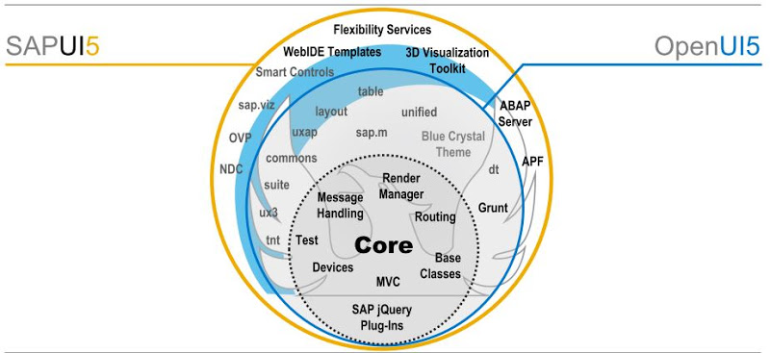
Open UI5 v/s SAP UI5?
Open UI5 is subset of SAP UI5 which is free for use, it comes under open source Apache license. Anyone can use, adapt and change the UI5 framework. However SAP UI5 is a licensed product which comes with SAP NW.

Slide 49
Funda Fox:
“this” is the object of controller (with in the controller, object of controller)
Technique to define global variables
variablename: value,
Inside of onInit method, write this.variableName = value;
Using scaffolding template
When it comes to js view, this pointer will only and only work as a controller object provided the object of controller is passed explicitly.

Slide 50
Model: in MVC architecture the model is represented by Data. This data can come from an SAP server or hard coded inside project files. Depending on the source and format of data we have verity of models to choose from.
We have four types of models in SAP UI5
JSON Model
XML Model
Resource Model
OData Model
Client Side Model: A client side model is used to keep all the data in client (downloaded in browser @ one shot), There no communication to server. The usage of client side model is, cases when we want data to be exchanged between view. We can use them in cases where the volume of data is small. It is like Internal table and Work area in ABAP.
Server Side Model: A server side model is used when there is a communication required to SAP server, The communication happens through request and response (via HTTP). Most suitable for creating real-time business applications on top of ERP.

Slide 51
Steps to work with a Model:
Create the model object
var oModel = new sap.ui.model.modeltype.ModelObj();
var oModel = new sap.ui.model.json.JSONModel(); -- Create a json model
var oModel = new sap.ui.model.xml.XMLModel(); --create an XML model
var oModel = new sap.ui.model.resource.ResourceModel();
var oModel = new sap.ui.model.odata.v2.ODataModel(); -- V4 is the latest Odata model object
Set the data or Load the data to model object
oModel.setData( data in required format );
oModel.loadData(“path of file”);
Make the model aware to your UI or Application or UI Control. We must set the model at App level OR View Level OR Control level.
sap.ui.getCore().setModel(oModel); --application level
this.getView().setModel(oModel); --View Level inside controller write the code
this.getView().byId(“control id”).setModel() --Model object @ control level
Whenever we want the data to be loaded in UI, The UI Control (text field, label, table) has to bind the address (path) of the model data.

Slide 52
Funda Fox:
It doesn’t matter which type of view you use, You can choose any model of your choice.
If your data is in JSON format, use JSON model.
Sample JSON to build path:
Every curly braces is represented by /
Every [] is represented by /index

Slide 53
{
"empTab": [
{
"empNo": 100,
"empName": "Anubhav",
"salary": 800,
"currency": "EUR",
"skills": ["ABAP", "Webdynpro", "UI5"]
},
{
"empNo": 200,
"empName": "Archana",
"salary": 900,
"currency": "USD",
"skills": ["OOPSABAP", "AoH", "S/4"]
} ],
"empStr": {
"empNo": 999,
"empName": "Roger",
"salary": 999,
"currency": "INR"
}
}
/empStr/empName→Roger
/empTab/1/empNo→200
/empTab/1/skills/0→OOPSABAP
/empTab/0/skills/1→Webdynpro

Slide 54
What is a model?
Model is an object and if want to manipulate data inside model we can use the methods of this object.
Change the data of model
oModel.setProperty(“path”,”value”);
oModel.getProperty(“path”);
Property Binding: When you bind UI control’s property to Model path, it is property binding.
Exercise: Every time i click on button, it should toggle field read only to enabled and vice-versa.
Model (Object)
View
json
/empStr/empNo
UI Field 1
/empStr/empName
UI Field 2

Slide 55
One Way : Data from the model will reflect in the view but vice-versa not possible.
Two Way : Data from model will reflect in view and vice-versa will happen.
One time: is like one way binding but only works when view loads at first time. After that there is no connection between view and model.
What is the default binding mode for JSON also XML model?
Two Way
Can we change binding modes for model?
Yes.
Can we use multiple models in an Application?
Yes, When we work with multiple models, the application should be able to differentiate between these models.
Use Named model control to set multiple models @ app level.
Two twin brothers joins a company and both have same name.
Employee ID
How to bind with named model?
When you have name of a model, you can use modelName> in binding.
Exercise:
On click of print button, flip the model objects, as a result we should see the data in fields will change.

Slide 56
Syntax to be used in binding:
option 1: use of curly braces with path
{json path}
Option 2: path as a prefix.
{ path : ‘json path’ }
Funda fox:
Whenever we use the binding syntax as option 2, we must use a setting in bootstrap to tell SAP UI5 that the binding type is of complex binding.
data-sap-ui-xx-bindingSyntax="complex"

Slide 57
Columns
Input Field | CheckBox
Rows
label: decide the title of the column
template: it receives a UI control object and this will decide what type of cell will be created.
Funda Fox: When we put columns inside table, it is important to assign the template property along with label to display the desired columns and cells.

Slide 58
Absolute path and relative path: An absolute path is the path with which the parent control is connected, usually it is root child of dataset. The relative path is the path with which the child elements of a control connects. System will treat relative path as a subset of absolute path. These paths are used in cases of Aggregation binding where parent control (table) binds to Absolute path and childrens (columns) binds to relative path.
Exercise: Make the Employee name editable. Remove multi select for table, it should only allow single selection. Marital status should be a dropdown (combobox), with 2 values (Married and Single).
Pass by value – The value of a variable passed to the function.
Pass by reference – The pointer to the memory is passed to the function.
Funda Fox:
Every event handler method in SAP UI5 will received an event object, which carries the information about the action taken by user on UI and also the information about the UI Control on which action was taken. Example when we select a table record, an event object will tell me which row of the table (index) was selected by user.
This event object has some methods like
oEvent.getParameter(“pname”);
oEvent.getSource() – object of source control, so we don’t need to do this.getView().byId();
oEvent.getParameters();

Slide 59





Slide 60
Element – memory allocated for each record
Model Data
/empTab
100 Anubhav 99 EUR
Table
Row 1
Row 2
Row 3
/emptab/0
/emptab/1
200 Archana 900 USD
/emptab/2
300 Sonali
bindElement(path)
Simple Form
Input Fields
empStr
999 Roger 950 EUR

Slide 61
Property binding always use relative path. Aggregation and Element binding is used to set absolute path.
View
Expression
Model
UI Element
Anubhav
Formatter function
CONVERSION_ALPHA_INPUT
CONVERSION_ALPHA_OUTPUT
When we apply formatter, that particular filed becomes one way binding.
Syntax for expression binding:
{= condition ? True(what todo) : Else(what to do)}
Within the expression binding you can use binding element properties also like ${path}

Slide 62
Xml Model makes use of XML data.
OTR – Online Text Repository ?
Translation.
Internationalization : standard which tells that software should support multiple languages. This purpose SAP UI5 provides me a technique called Resource Model.
All the texts relevant for UI element Labels and translation are kept in a separate file, later these texts are translated to different languages.
+
As a developer your job is to make sure that labels are used only and only from the internalization file (i18n.properties). Create resource model and bind the labels from the UI texts.
Once the deadline for development close is done, UI is frozen. The KM developer starts translation of UI labels, He/she creates a copy of i18n file and creates language specific files with lang. Codes. Example, if i need software to run in hindi language, the language code is hi.
Developer
KM Developer
(Doc. & translation)

Slide 63
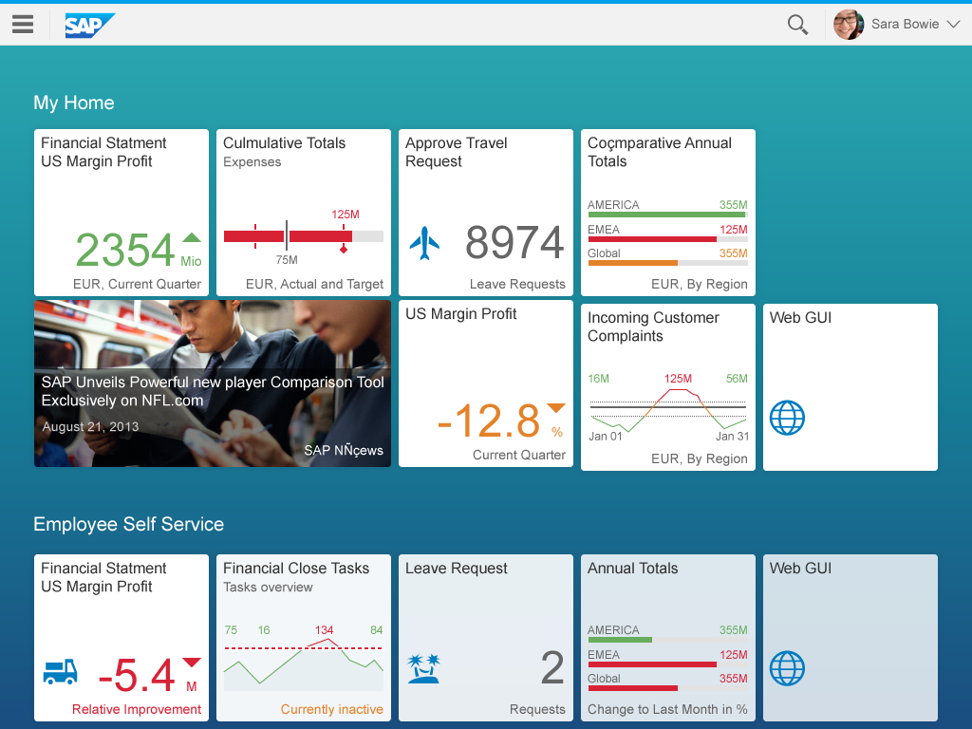
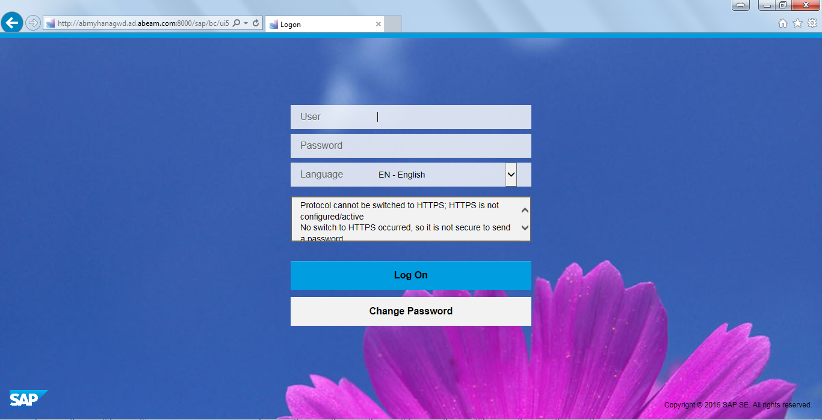
How do business users launch fiori apps:
Fiori apps are accessed by a single starting point for app applications called SAP Fiori launchpad.
?sap-ui-language=<lang code>

Slide 64
By far we saw how to create user interface using SAP UI5. But we have a concept called UX (User eXperience).
What is difference between UI and UX.
UI is the technical user interface however UX is how user is used to using apps. You can change UI but cannot change UX.
You must try to make your UI as close to UX as possible.
Fiori is all about UX. There are UX guidelines provided by SAP to make sure that if you create your application using these guidelines, you will be able to achieve a great user experience.
http://design.sap.com/fiori-ux.html
https://experience.sap.com/fiori-design/
http://sapfioritrial.com
Fiori apps created by using SAP UI5 framework.

Slide 65
Fiori UX application:
Index.html
View.xml
Return oControl;
Object of view
Fiori Application always has a container control (usually sap.m.App) which encapsulates all the views.
parents
Index.html
Main.view.xml
sap.m.App
Brother 1
Brother 2
Second.view.xml

Slide 66
List Control: Is a single column table, used to display multiple items.
List
header
Item 1
Item 2
Item 3
...
...
items
Path: binding path from where it takes the data from (optional)
Template: decide which type of list item we want to use

Slide 67
sap.m.ListBase
sap.m.ListItemBase
items
sap.m.DisplayListItem
sap.m.StandardListItem
sap.m.List
sap.m.ObjectListItem
sap.m.ActionListItem
sap.m.InputListItem
sap.m.FeedListItem
sap.m.ColumnListItem
sap.m.CustomListItem

Slide 68
500 fruits, will you add 500 list items manually like today?
No.
What would do?
Binding. - aggregation binding with list control (just like rows of tables)
Exercise: Design a json for fruit store. This JSON will have 3 entitysets (fruits: [], cities: [], suppliers: [])
Each ES has to have multiple records, May be 20 Fruits, 10 cities and 15 suppliers.
Fruits (20): name, color, benefit, availability (Available, Out of Stock, Discontinued), image, price, currency
Cities (10): city, state, famous
Suppliers (15): name, city, sinceWhen (yyyy-mm-dd), country, supplierId (1001,1002,1003,1004)
Deadline Next 12 hours.
Nagpur – The Orange City. Nagpur is synonymous with Oranges. ... Mahabaleshwar – Strawberry. ... Ratnagiri – Alphonso Mangoes. ... Nashik – Grapes. ... Siliguri – Pinapples. ... Jalgaon – Bananas. ... Dahanu Bordi – Chiku Orchards. ... Goa – Cashew Nuts

Slide 69
odata
JSON Model which is global

Slide 70
SAP Fiori Worklist Application: An application where first screen displays list of data and when we select an item, it navigates to next screen and display details of selected item.
Transactional App
60%
Analytical App
40%
Fact Sheet App
Work List
OVP
Master Detail
ALP
Editable
Smart Filter
SAP UI5 kind
KPI Tile

Slide 71
SplitApp
Master
Details
First
Second

Slide 72
In real time Fiori apps we do not use App or SplitApp for navigation, we use concept of Router.
For (var i=0;i<oList.getSelectedItems().length;i++)
{
console.log(oList.getSelectedItems()[i].getBindingContextPath());
}

Slide 73
Input
getBinding(“name of aggregation or property”)
getBinding(“items”).filter()
oContext = getBindingContext(“path”)
Data object
Leave req of user
1000s of req
HANA

Slide 74
Table in Fiori (sap.m.Table)
Is a multi column list control.
Component.js
Component.js in SAP fiori wraps the complete functionality of your application. If you want to integration your fiori application to SAP Fiori Launchpad, You must use a Component.js file in your application.
Technically, it is a reuse of sap.ui.core.UIComponent class.
Funda fox:
if you want a fiori application called as “fiori-like app” You must have to have Component.js in your app.
You must always have one Component.js file at the app level, it is not possible to have more than one component.js file inside an app.
The file name HAS to be Component.js
it is a good practice that we put the file inside the root folder.

Slide 75
Index.html
masterPafges
View 1
detailPages
SplitApp
View 2
KILL the dependency on Index.html, remember that in a productive fiori app system, there is no concept of index.html.
Index.html however will be used for local testing.
Index.html
Component.js
(Wrapper for everything)
App
masterPafges
Component Container
View 1
App.view.xml
SplitApp
detailPages
View 2

Slide 76
Component.js drives followings:
Information about your application like version, name, author, type
Details about supported devices and themes
Odata service information
Complete end to end navigation between pages and views – Object inside Router
Dependencies on SAP UI5 and Fiori
Dependencies on other app
ABAP system deployment information
Models – JSON, XML, Resource, OData
Global methods
Manifest.json – it is a json file which has details about your entire application.
{
//fiori app version and details like directory of i18n, application title, description etc.
“sap.app”:{},
//Dependency management for ui5 libs and themes, devices etc.
“sap.ui”:{},
//Routing configuration for navigation between views
“sap.ui5”:{}
}
Manifest.json
Application Descriptor

Slide 77
Router: Is a ready made object offered by UI Component class which is used to create Component.js
Router takes care of followings:
Instantiation of all the views including App View.
It controls the complete navigation of your application. In order to do that, Router need Routing configuration. The routing configuration is maintained by developer inside Manifest.json
Anubhav where is your session recordings
Open a browser, a browser is an application in windows to browse internet. Make sure you know what is internet and computer.
After opening type the below link : https://sites.google.com/site/sapfioribatch717/
Wait for some time till the page loading completes.
On the top you will see title sapfioribatch717
There is a toolbar on top, in which you are at Home page
Search if you can find Session recording tab
Use your mouse left click to click on that tab.
If yes, you can see session recording.
Sales order-> one of line item -> line item details -> scheduling info
Taking user to a direct place where the right information lies. Every url has an end point addressing to a unique page.
When we have multiple url end points and we navigate, the browser tracks the end points automatically. All the browser will keep track of history and browser back and forward button will work.

Slide 78
Steps to use Router in SAP Fiori
Invoke the router
in init function of Component.js, we need to call parent class. this.getRouter()
You need to now call initialize() method of the router
2. Make sure before we do that, we must specify the Routing configuration
2.1 – the root view – the initial view which will be launched. App.view.xml
Define it in sap.ui5 section as a json, view name, type, id
2.2 – define main routing configuration to load your other views inside the split app or app.
“routing”:{
“config” :{
//router class
//view types
//view path
//control id
},
“routes”:[
{
pattern : url end point,
name: “name of the route”,
target: “target1”
],
“targets”:{
each target is equals to one view instantiation
}
}

Slide 79
Funda fox:
When we have new application structure including App view, we need to set the data model at App view level never at application level.
Master
Detail
onInit: function(){}
Everytime the view is displayed again, we need the method.
RouteMatchedHandler
RoutePath

Slide 80
Component js – it is a wrapper of complete application functionality, used for LPD integration.
Manifest.json – JSON file which complements Componentjs, All the required properties, dependencies, routing config, themes, model etc. Defined inside 3 sections of manifest file,. This was linked to Component.js.
Router – In order to create the object of all the views, and navigation between views was taken care by Router. Mandatory specify the routing configuration. Initialized the router.
History has to be keep tracked, element binding needs to be done with selected item. How do we know inside detail view what was selected by user?
Get the list object and get selected item index. This way will not let the browser track every selection. To make every selection unique, we have added a variable to Route.
When we select the item we are passing variable value (thor).
We have to implement a RouteMatchedHandler method which will trigger every time the Route changes. In this method now we can read the route index and bindElement with view for the item.

Slide 81
SAP UI5 doesnt become a bottleneck for developer.
If there is a UI control which you may need, and not available in Standard controls. You can design your own control.
Which is immediate the parent class of all the UI5 controls?
sap.ui.core.Control
Which keyword you use in JS to indicate inheritance?
extend
What SAP UI5 does behind scenes?
Converts the code to Equivalent HTML.
SAP UI5 Runtime Environment – Renderer
Exercise:
In this custom control heading, add a property for background color and border color. We should be able to pass the property from our xml view.

Slide 82
Google offers verity of services on internet, at the same time it allows us to integrate these services with our web applications. For integration purpose, it provides us different JS APIs.
How did you refer the jQuery?
<script src=“path” >
How to integrate:
Reference the google map api java script API in your application.
Create a custom control, this custom control when used, produces a div tag.
We will call the google map API and this API will generate the map and place inside the area (you have to pass address of the area where the map will display).
Map
Screen

Slide 83
Fragments : Light weight UI parts used to modularize the Application UI. They are typically created as a separate file and combined with views @ Runtime or design time.
Funda Fox:
They do not have their own controller. They relay on controller of host.
Parasite: which doesnt cook its food own its own, it relies on the food cooked by host.
Exmple: I have a need to create address fields again and again, like permanent address, temp address, office address etc.
Typically address UI has fields like Name, Address line, Landmark, pin code, city, country, PO Box, Street, House no.
Controller
Validate: function(){
}
View
Permanent
Office
Temporary
Fragment
Address Data fields
validate

Slide 84
Define:
<core:FragmentDefinition xmlns:core=“sap.ui.core” xmlns=“sap.m”></core:FragmentDefinition>
Consume The fragment in View (Embed mode)
<core:Fragment name=“path”>
Instantiating the object of Fragment using JS code
var oFragment = new sap.ui.xmlfragment(“path”, this);
oFragment.method();
Use Case:
You are working in the fruit store software department, you need to design 2 popups.
When user click on settings button on the table toolbar, a popup with supplier details should appear.
When click on F4 help of our input field, a City popup should also come up. On selection of a city in the popup, the city should be added to the input field.
What is common in above 2 requirement?

Slide 85
View
View
Fragment
View
Views
Controller
Model

Slide 87
OData Stands for Open Data Protocol, widely used to communicate over internet these days. It follows REST (Representational State Transfer) principle.
Odata is not SAP technology. Odata was initially developer by company called OASIS, later acquired by Microsoft. It is an open source.
Any communication over the HTTP protocol, will be with Odata service.
Funda Fox:
Odata is the way to communicate with SAP Backend from Fiori.
This is one of the only way for HTTP communication to your SAP Server.
Odata is not the Webservice concept used in SAP earlier.
SAP Servers for Odata and S/4HANA & CDS & HANA & SQL Script & Analytical Apps & Launchpad & Fiori Extensions:
Use your own company server.
Dedicated server – S/4HANA OP 1610 – NW 7.52 with Fiori 2.0 with ADT Access -2500 INR per month per user
Practicing every thing including ABAP on HANA, Fiori and Odata.
Local access of SAP GUI to SAP Server, Locally you can also access Odata services built inside the server. Deploy Fiori applications and test them with Fiori launchpad . You can also connect ABAP server from ADT (ABAP Development Tools for Eclipse – ABAP on Eclipse), connect to HANA DB from HANA Studio (Remote)
Free server from SAP – You cannot do development in the system. Demo system with only read access. ES4 and ES5 servers. All the read scenarios for Odata can be tested with this free server.
Cloud Application Library – (Cost per hour for a computer online from AWS or Azure -1.63 USD per hour 12000 INR)
If you want to access Odata service from local computer, you need setup SAP Cloud Connector in the server.
https://www.youtube.com/watch?v=yrk4BjXSdy8&feature=youtu.be&list=PLcxqFaocb9WLtnq-rpXbRy5hnKECxr95G

Slide 88
Presentation
Browser + Mobile Devices
Fiori
odata
Embedded Scenario
Central HUB
Application
NW 7.4>
SAP Gateway – Support for OData
Hosts your Fiori Apps, Fiori Launchpad, Roles,
Theme Designer
SAP ECC
SAP CRM
DB Layer
HANA

Slide 89
SAP hosts 2 free servers on internet for Odata practicing
These internet facing SAP Servers, so you don’t need SAP Cloud connector in middle.
https://blogs.sap.com/2017/06/16/netweaver-gateway-demo-es5-now-in-beta/
https://www.sap.com/india/developer/tutorials/gateway-demo-signup.html
https://sapes5.sapdevcenter.com/sap/bc/gui/sap/its/webgui?sap-client=002&sap-language=EN
https://sapes5.sapdevcenter.com/sap/opu/odata/IWBEP/GWSAMPLE_BASIC/
http://hxehost:8090/demo/DemoProject/services/onView.xsodata/MyView?$format=json&$select=COMPANY_NAME,GROSS_AMOUNT
service {
// Aggregation example: A view with ID Amount, Month, and Year columns created in sample.test package.
// Call http://host:port/package/file.xsodata/MyView?$select=Year,Amount
"_SYS_BIC"."demo.DemoProject.models/SALES_WORKLIST" // Table or View
as "MyView" // Optional entity alias
with ( "SO_ID","COUNTRY","COMPANY_NAME","CATEGORY","GROSS_AMOUNT") // Optional list of exposed columns
key ("SO_ID") // Optional key relevant for view
aggregates always (SUM of "GROSS_AMOUNT"); // Additional aggregation per column are MIN, MAX, AVG
}

Slide 90
Client
Header + Request Body
Server
(Java, ABAP, NodeJS,.NET)
Header + Body (data)
Header
Types of data – text/plain, application/json
Type of Req –
POST - Create
GET - Read,
PUT - Update,
DELETE – Delete,
MERGE – Read and update
SQL
DB
Benefits:
Open Source
Simple to use, perform verity of operations – CRUD
Hides the complexity of SQL behind the scenes, Odata is an abstraction of SQL.
Industry standard
Multiple technologies to create Odata
It is stateless which means many users can talk to Odata server simultaneously

Slide 91
OData service in SAP looks like below
https://sapes5.sapdevcenter.com/sap/opu/odata/IWBEP/GWSAMPLE_BASIC/
http:// host_name : port_number / path prefix / serviceName
You can pass instructions to your server using url parameters, the server can understand these values and can behave accordingly
/url?firstParam=value&nextParam=value&nextParam2=value
$ indicates Odata operators like $top, $skip, $select, $filter, $expand, $count
Odata service comes with 2 important documents
Odata Service Document – This will contain the information about Entity Set. Each Entity Set is an access point of some data. For example, if we want to create, read data for product, we have to use ES ProductSet.
Odata Metadata Document – Includes the metadata information of each Entity Type, An Entity type is a blue print of EntitySet. It includes all the properties and key fields.
{
“fruits” : [],
“city”: [],
“supplier”:[]
}

Slide 92
Service document
https://sapes5.sapdevcenter.com/sap/opu/odata/IWBEP/GWSAMPLE_BASIC/
Service Metadata Document
https://sapes5.sapdevcenter.com/sap/opu/odata/IWBEP/GWSAMPLE_BASIC/$metadata
How to access data from EntitySet → /EntitySet
https://sapes5.sapdevcenter.com/sap/opu/odata/IWBEP/GWSAMPLE_BASIC/ProductSet
How to count number of records
https://sapes5.sapdevcenter.com/sap/opu/odata/IWBEP/GWSAMPLE_BASIC/BusinessPartnerSet/$count
Load data in json format
https://sapes5.sapdevcenter.com/sap/opu/odata/IWBEP/GWSAMPLE_BASIC/ProductSet?$format=json
Imagine you have 1 Bn Sales Orders in system (ERP), If you try to load all records using Odata in Mobile app, will it ever work?
We do paging, load data chunk by chunk. Initially load only x records (20), When user does action on UI like scroll in table or in list, load next chunk of x records. Similar to Buffering concept in youtube.
Loading chunk of size 2
https://sapes5.sapdevcenter.com/sap/opu/odata/IWBEP/GWSAMPLE_BASIC/ProductSet?$format=json&$top=2
How to load next chunk by skipping first chunk
https://sapes5.sapdevcenter.com/sap/opu/odata/IWBEP/GWSAMPLE_BASIC/ProductSet?$format=json&$skip=4&$top=2
Selection of certain columns
https://sapes5.sapdevcenter.com/sap/opu/odata/IWBEP/GWSAMPLE_BASIC/ProductSet?$select=ProductID,Name,Price&$top=1&$format=json

Slide 93
Read Based on PK (In this example ProductID) SELECT SINGLE with PK
https://sapes5.sapdevcenter.com/sap/opu/odata/IWBEP/GWSAMPLE_BASIC/ProductSet('HT-1010')?$format=json
Funda Fox:
The url never understand special characters and spaces. System will automatically convert them to some %Char.
Search based on where criteria using $filter
https://sapes5.sapdevcenter.com/sap/opu/odata/IWBEP/GWSAMPLE_BASIC/ProductSet?$format=json&$filter=Category%20eq%20%27Projectors%27
https://sapes5.sapdevcenter.com/sap/opu/odata/IWBEP/GWSAMPLE_BASIC/ProductSet?$format=json&$filter=substringof(%27lenovo%27,%27Name%27)%20eq%20true
http://services.odata.org/V3/(S(4htcwchwu3wzeolz004ehxym))/OData/OData.svc/Products?$format=json&$filter=substringof(%27Cola%27,Name)%20eq%20true
Association: Reading data between multiple entities. VBAK and VBAP
https://sapes5.sapdevcenter.com/sap/opu/odata/IWBEP/GWSAMPLE_BASIC/SalesOrderSet('0500000002')/ToLineItems?$format=json
Loading main and sub entity data together
https://sapes5.sapdevcenter.com/sap/opu/odata/IWBEP/GWSAMPLE_BASIC/SalesOrderSet('0500000002')?$format=json&$expand=ToLineItems

Slide 94
Orders
1000005

Slide 95
EPM – Enterprise Procurement Model
Only used for practice, demo and training scenarios. Its has sample database tables related to product, purchase orders, BP, sales etc.
There are multiple FMs for performing CRUD operations on these entities
BAPI_EPM as the starting name of the function module.
BAPI_EPM_BP_GET_LIST = all the Business Partners in the system.
BAPI_EPM_BP_GET_DETAIL – read single BP
BAPI_EPM_BP_CREATE – create a new BP
BAPI_EPM_BP_UPDATE – update bp
BAPI_EPM_BP_DELETE – delete the BP
BAPI_EPM_PRODUCT_CREATE – create a new product
BAPI_EPM_PRODUCT_DELETE – delete product
BAPI_EPM_PRODUCT_GET_LIST – get the list of all products
BAPI_EPM_PRODUCT_GET_DETAIL – get details of single product

Slide 96
Runtime Artifact: It includes the placeholders (actually ABAP classes) which will contain the programming code to support the requests coming to Odata, these requests could be accessing
service document
metatdata document
get operation on ES
post operation on ES
put operation on ES
delete operation on ES
ABAP App Server
Browser
ServiceName, $metadata
Service /metadata Document

Slide 97
SAP Generates
MPC
DPC
Code Which We have to write
MPC_EXT
DPC_EXT
Risk of over writing sap generated code
When we regenerate our service project, All the custom code will be overwritten by SAP.
System generates a class which has SAP generated code and also another class called EXTENSION Class which can be used to write our own code. This way we safeguard SAP generated code and custom code.
Service metadata – Model Definition – Model Provider Class
Service Implementation – Model Implementation – Data Provider Class
Odata Project name _SRV will be the name of the Odata Service which will be generated, needs to be registered once.

Slide 98
SEGW - SAP Gateway Service Builder
/IWFND/MAINT_SERVICE - Activate and Maintain Services
/IWFND/GW_CLIENT - SAP Gateway Client
/IWFND/ERROR_LOG - SAP Gateway Error Log
For every entity which method to use for implementation
GET_ENTITYSET – Support all the Get operations which supppose to return Multiple records ($top, $skip, $filter, $select etc)
GET_ENTITY – Return only single record based on key
CREATE_ENTITY – Create the new record
UPDATE_ENTITY - update
DELETE_ENTITY - delete

Slide 99
Structure of SELECT OPTION in ABAP
SIGN, OPTION, HIGH and LOW
If you are a good developer, your 30% code is exception handling.
0% - Bad coding
<Table id="idTable" items="{path: 'category3', parameters: {select: 'MaterialID,MaterialDescription,VendorName,TotaliLPN'} }“
Var oTable = this.getView().byId(“idTable”);
oDataModel.read(“entityset?$select=cols”, function(){
set your json model
});
oTable.bindItems({
path: “/EntitySet”,
Template: new sap)
oTable.getBinding(“items”).filter(“”);

Slide 100
Fiori
Application Layer
Workflow, batch job, back ground prog, manipulation
Example: which is the most expensive product in my system.

Slide 101
Config File
Rows, Col, Data
Code+OOPS
Compile
Run
JRE, Compiler
Framework
Most common tasks which you want
OS
HW
Output

Slide 102
Component.js
Controller
oDataModel
oDataModel.read(“/ES”,{filters: []},
Success: function(data)
View
List
items: “/localJSONES”
Manifest.json
1
2

